Slide 1




Slide 2
Purpose
As cities grow larger, the need for parking space diminishes with time.
People have nowhere to park their vehicles making it very stressful for the drivers.
Instead of spending precious minutes finding a space, users will know beforehand where it is convenient to park.
This application is focused on parking lots of major cities in which population is incredibly dense and people live in continuous stress.

Slide 3
Quest
A new application that is responsible for locating the places available in the best area to park your car in the parking lot.
It will implement a base intelligent system that will be able to determine the best possible solution in order to find an adequate parking space.
The objective of implementing such program, is to facilitate parking and make life much easier for everyone that owns a vehicle and needs to find a place to park.

Slide 4
Overall description
Product functions
With Quest’s algorithm, we will be able to provide an efficient way to find an available parking space for our users. Dividing parking lots by zones and matching those to what the user is searching for will make it efficient and simple to find a place to park your vehicle.
User characteristics
Quest is designed to be as user friendly as possible. With a quick and intelligent design our clients will be able to find a place to park in a matter of seconds and save precious time in
things that actually matter.

Slide 5
Overall description
2.4 Constraints
Quest will require an Android system with the following hardware specifications: • Dual-Core 1Ghz or faster processor. • 512 GB RAM • Android OS 4.1 jelly bean or superior.
2.5 Assumptions and dependencies
The sensors (button, touch, LCD and beacons) are the pillar of our application, if there exist any kind of interference, the information stored in the database will be erroneous. Also if the database
service collapse in some moment, the application will not be able
to deploy the zones in the map.

Slide 6
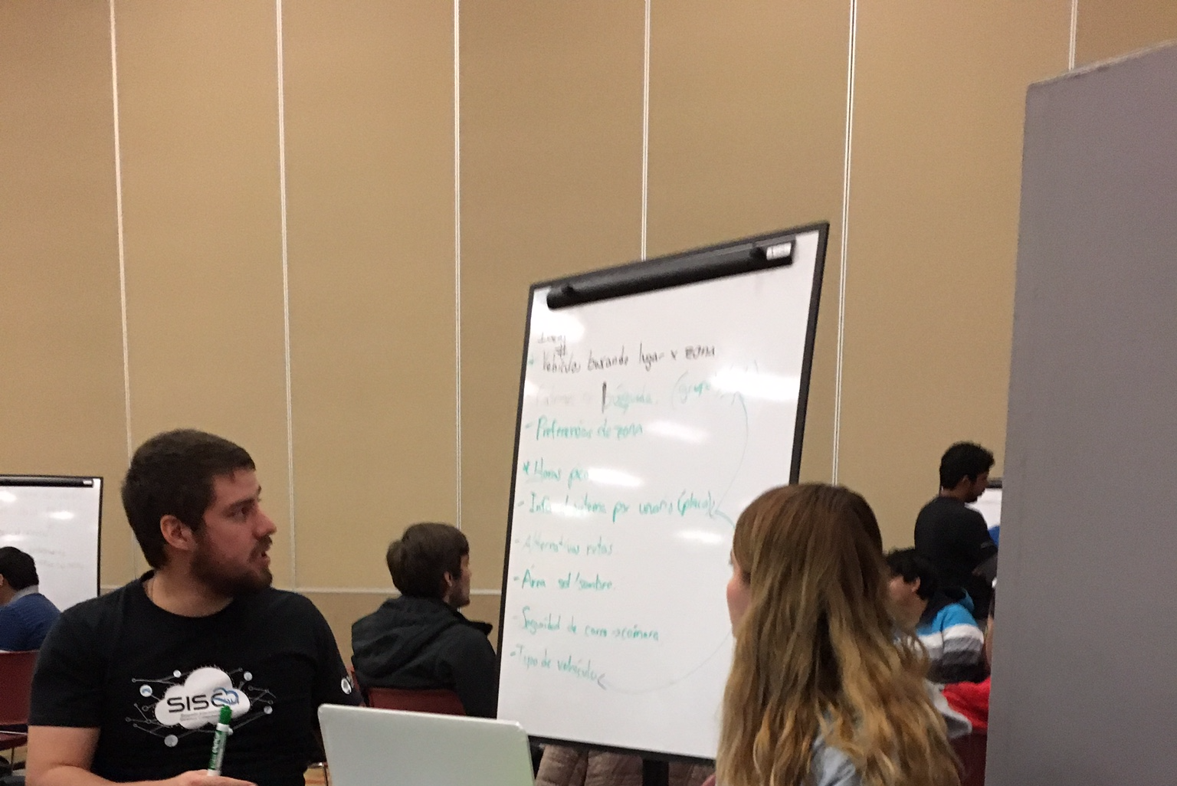
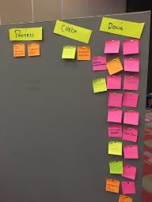
Organization
First, the team planned a schedule with the necessary tasks and activities for each member of the team.

Slide 7
Activity schedule
Day one:
The Edison cards were configured.
Firebase were connected with HTML
The task were assigned to each member of the team.
Name and slogan of the project were defined.
Day two:
The Edison cards were communicated with a local file that simulated the behavior of a database, in addition, these files were accessed by an address with a previously installed server Json in Edison.

Slide 8
Activity schedule
Day three:
The database’s structure was changed.
The individual parts of the app were finished such as the windows and the login. These take information of Firebase
Day four:
The code was cleaned.
The documentation was structured.
The virtualization was finished.
The model was finished.
The webpage and the documentation were finished.

Slide 9
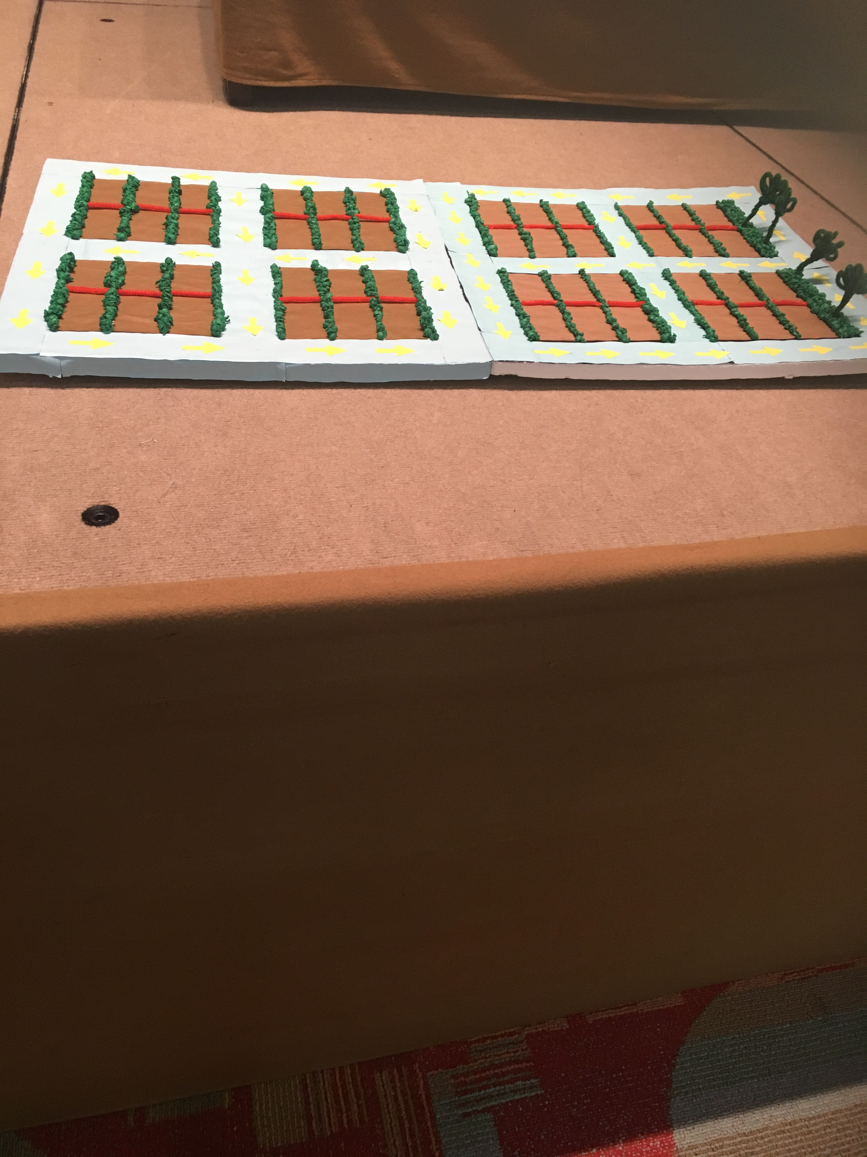
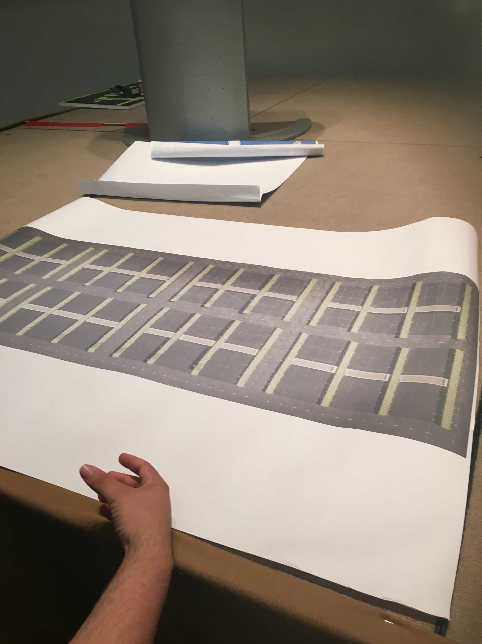
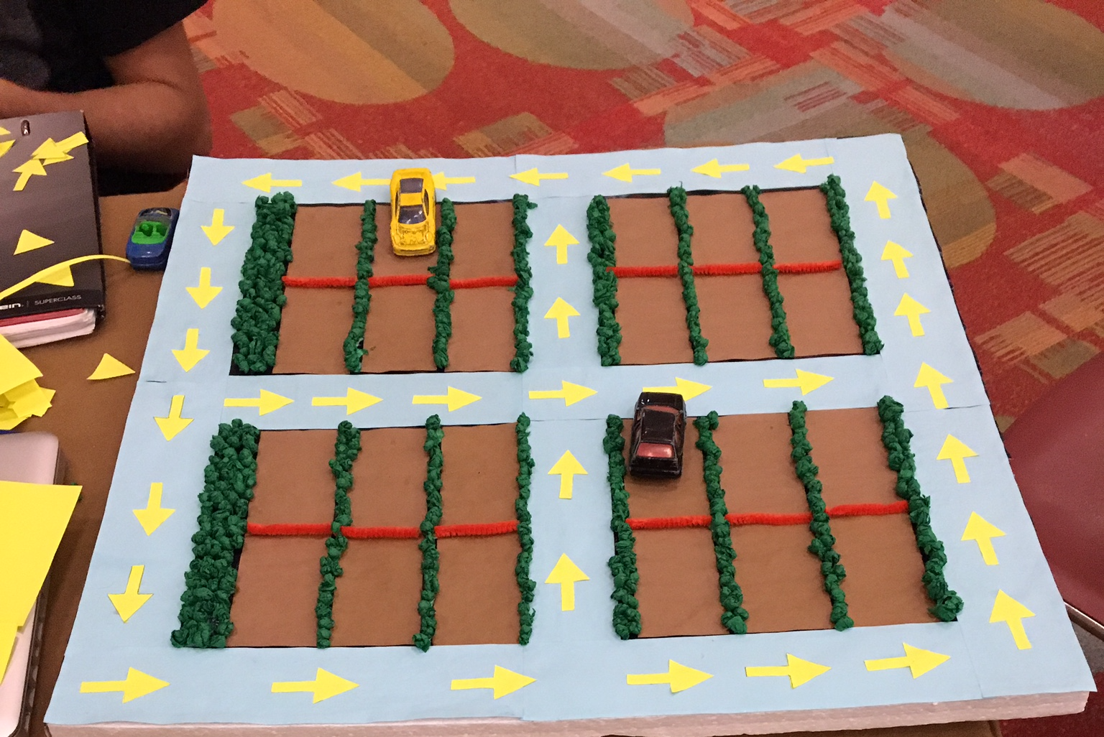
Model Sketch
It was necessary to build a model sketch of our system as a scale prototype to test the program and analyse the system functionality and requirements.

